Slide 1
Intel 8085 Microprocessor Addressing Modes

Slide 2
Addressing Modes of 8085
◆ To perform any operation, we have to give the corresponding instructions to the microprocessor.
◆ In each instruction, programmer has to specify 3 things:
Operation to be performed i.e. Opcode
Address of source of data i.e. Operands
Address of destination of result.

Slide 3
Definition
◆ The various ways of specifying operands for an instruction are called the addressing modes.
◆ The various addressing modes that are defined in a given instruction set architecture
define how machine language instructions in that architecture identify the operand(s) of
each instruction.
◆ In any microprocessor instruction, the source and destination operands can be a
◆ Register
◆ Memory Location
◆ 8-bit number
The method by which the address of source of data and the address of the destination of the result is given in the instruction are called the Addressing modes.

Slide 4
8085 uses the following addressing modes:
Implied/Implicit Addressing Mode
Immediate Addressing Mode
Direct Addressing Mode
Register Addressing Mode
Register Indirect Addressing Mode

Slide 5
Implied/Implicit Addressing Mode
◆ In implied/implicit addressing mode the operand is hidden and the data to be operated is available in the instruction itself.
◆ If address of source of data as well as address of destination of result is fixed, then
.
◆ Examples:
◆ CMA (complement accumultor )
◆ RRC (rotate accumulator A right by one bit)
◆ RLC (rotate accumulator A left by one bit)

Slide 6
Immediate Addressing Mode
◆ In this mode, the operand is specified within the instruction itself.
at memory location N followed by the higher order data byte at memory location
◆ Examples:
◆ MVI B 45 (move the data 45H immediately to register B)
◆ LXI H 3050 (load the H-L pair with the operand 3050H immediately)
◆ JMP 4050 (jump to the operand address immediately)

Slide 7
Direct Addressing Mode
◆ The data to be operated is available inside a memory location and that memory
location is directly specified as an operand.
◆ The operand is directly available in the instruction itself.
◆ Examples:
◆ LDA 2050 (load the contents of memory location into accumulator A)
◆ LHLD 3050 (load contents of 16-bit memory location into H-L register pair)

Slide 8
Register Addressing Mode
◆ In this mode, the operand is in general purpose register.
operands. Therefore the operation is performed within various registers of the
◆ Examples:
◆ MOV A, B (move the contents of register B to register A)
◆ ADD B (add contents of registers A and B and store the result in A)
◆ INR A (increment the contents of register A by one)

Slide 9
Register Indirect Addressing Mode
◆ In this mode, the address of operand is specified by a register pair.
◆ The data to be operated is available inside a memory location and that memory
location is indirectly specified b a register pair.
◆ Examples:
◆ MOV A, M (move the contents of the memory location pointed by the H-L pair to the
accumulator)
◆ LDAX B (move contains of B-C register to the accumulator)

Slide 10
Data flow between memory and MPU:
◆ First of all the 16-bit address is placed on the address bus from the program counter.
◆ Let say the address is 2005H where the data is placed.
◆ The higher order address i.e. 20H is placed on the address bus A8-A15 while the lower
order address i.e. 05h is placed on the multiplexed address and data bus ADO-AD7.
◆ The lower order address continues to remain on this address bus so long as ALE (Address Latch Enable) remains positive. Once ALE goes low it carries data.
◆ The control unit sends the signal to indicate what type of operation is to be performed. Since the data is to be read from the memory therefore it sends to enable the memory chip.

Slide 11
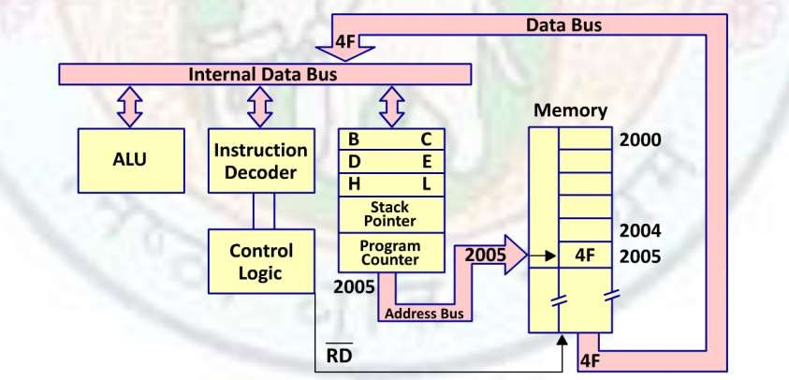
◆ The byte from the memory location is then placed on the data bus i.e. 4F saved in location 2005H is placed on the data bus and sent to the instruction decoder.
◆ The instruction is decoded and accordingly the task is performed by the ALU i.e. Arithmetic and logic unit.

Slide 12
8085 Programming Model:
A programming model is a conceptual representation of a real object and can be in the form of a text, a drawing or a built structure which gives information required to write a program.
It consists of some segments of ALU and the registers. This model includes six general purpose registers, accumulator, flag register, program counter and stack pointer.
This model is not a reflection of physical structure of the microprocessor but gives all the information that is relevant for writing an assembly language program.

Slide 13
